Slide 1
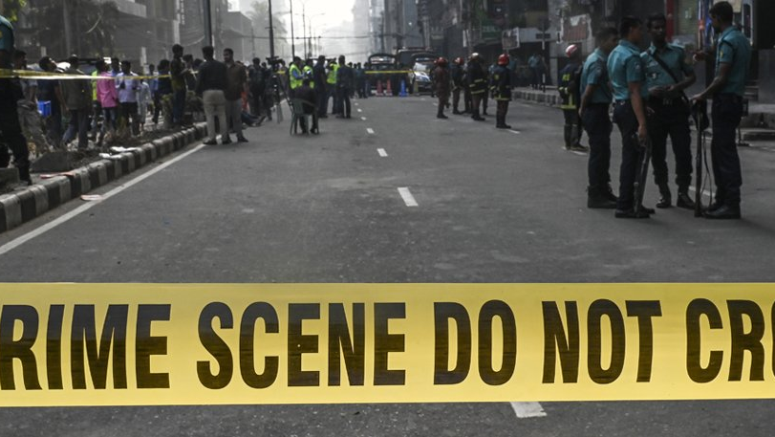
IN DHAKA CITY
CRIME
Presented by
SHOHANUR RAHMAN SHOHAN
FARJANA YESMIN OPI
LIDA KHAN MUKTI
NAZIM-E-ALAM
MD. ABU TOWSIF

Slide 2

What is
Crime
An act (or sometimes a failure to act) that is deemed by statute or by the common law to be a public wrong and is therefore punishable by the state in criminal proceedings
In ordinary language, a crime is an unlawful act punishable by a state or other authority
Criminology is the interdisciplinary study of crime and deviant behavior
In this presentation, we will discuss about the present and past scenario of crime in Dhaka city

Slide 3
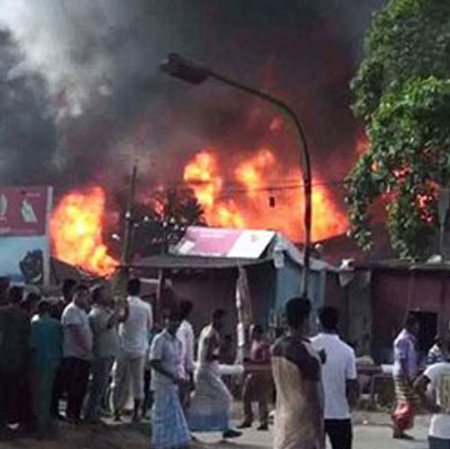
CRIME IN BANGLADESH OVERVIEW
Bangladesh, with its rich culture and history, is grappling with various types of crime that require comprehensive analysis and effective solutions
Crime is a multifaceted issue that affects societies globally, and Bangladesh is no exception
Rapid urbanization has led to increased population density and crime concentration
The rise of cybercrime has introduced new challenges, requiring the adaptation of traditional law enforcement strategies to the digital realm

Slide 4
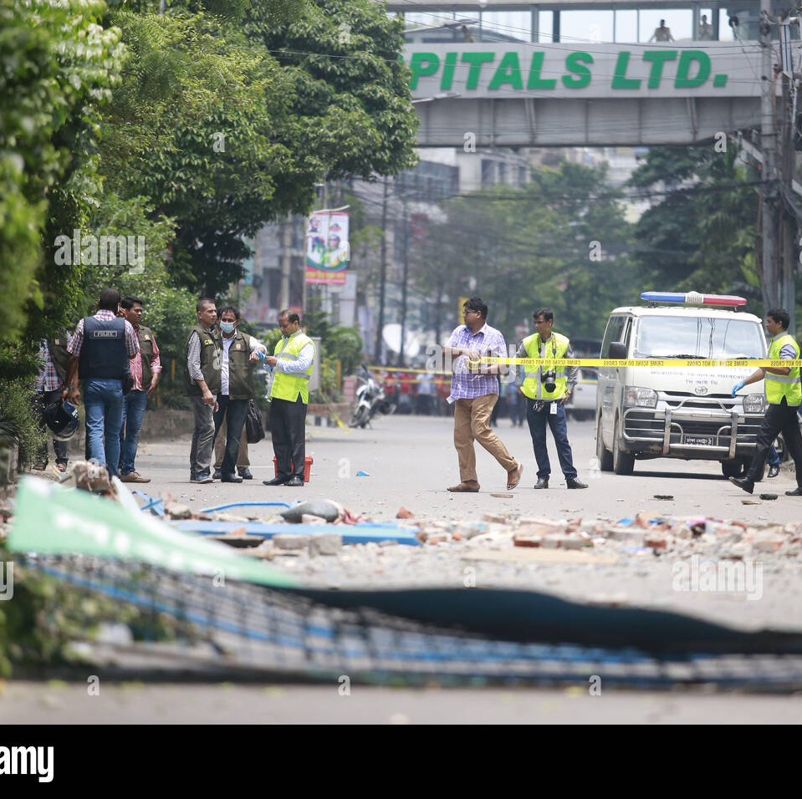
CRIME IN DHAKA CITY
Dhaka City, the bustling capital of Bangladesh, grapples with a diverse range of criminal activities that reflect the complexities of urban life
From street crime to cybercrimes, Dhaka City's crime landscape encompasses a spectrum of offenses that challenge law enforcement and society
Violent crimes, such as robberies and assaults, pose threats to public safety, prompting a need for strategic measures to ensure citizen protection
Women's safety remains a pressing concern, as gender-based violence and harassment persist in various corners of Dhaka City

Slide 5

TYPES OF
CRIME
STREET ROBARIES
Street robberies are common, especially in densely populated areas. Criminals often snatch belongings from pedestrians or motorcyclists, leading to instances of theft and assault
Pickpocketing
Crowded places like markets and public transport are breeding grounds for pickpockets who discreetly steal wallets, phones, and other valuables from unsuspecting individuals
Vehicle Theft
Carjacking and motorbike theft are prevalent, with criminals stealing vehicles for resale or parts. Lack of proper parking and security measures contribute to this issue.
KIDNAPPING
is a criminal act in which an individual or a group forcibly and unlawfully takes another person against their will, often with the intent to demand a ransom, inflict harm, or exert control over the victim
FRAUD
Scammers often exploit unsuspecting individuals through schemes involving fake investments, lotteries, or other fraudulent activities
Drug Trafficking
Dhaka City's urban environment attracts drug trafficking, with both local distribution and transit routes for international drug trade.

Slide 6
TYPES OF contd.
CRIME
DRUGS
The scourge of drug-related crimes continues to cast a shadow over Dhaka City, with illicit drug trade and abuse posing significant challenges. Law enforcement agencies are engaged in an ongoing battle to curb the distribution and consumption of drugs, striving to protect the city's communities from the harmful effects of addiction and associated criminal activities
Human Trafficking
Dhaka City serves as a source, transit, and destination point for human trafficking, affecting men, women, and children for various exploitative purposes
CYBER CRIME
Dhaka City experiences various forms of cybercrime, including online scams, hacking, and identity theft, as the digital landscape expands
FRAUD
Scammers often exploit unsuspecting individuals through schemes involving fake investments, lotteries, or other fraudulent activities
Environmental Crimes
Illegal waste disposal, air and water pollution, and other environmental violations contribute to the degradation of the city's ecosystem

Slide 7
DATA & STATISTICS

Slide 8
DATA & STATISTICS

